Slide 1

Sagar Institute Of Research & Technology
Department of Computer Science & Engineering
Submitted by:
<Student Name><(Roll No.)
Guided by:
<Faculty Name with initial
article either Mr. or Ms./Mrs.>
SIRT Bhopal

Slide 2
Contents
Introduction
Advantages
Role of Each Member
Software Development Life Cycle(SDLC) Model
Design
Specification
Testing

Slide 3
Introduction
This project is aimed to serve as a healthcare web app.
It takes the current location of the user and marks healthcare facilities in the radius of 2.5 miles on the map.
It can mark hospitals/clinics, veterinarians clinics and drug stores.
Provides address and phone number of the marked facilities.

Slide 4
Advantages
It helps the users figure out the exact location of nearby facilities and removes the word of mouth location inaccuracies.
Customized map marking according to the user’s current location makes it advantageous in emergency situations.
Access to the contact information of the facilities add to the connectivity between the user and healthcare.

Slide 5
Role of Each Member

Slide 6
Software Development Life Cycle (SDLC) Model
Big Bang Model.
Follows no specific process, and very little time is spent on planning.
The majority of resources are thrown toward development, and even the client may not have a solid grasp of the requirements.
This is one of the SDLC methodologies typically used for small projects with only 2 or 3 software engineers.
Not recommended for large projects.

Slide 7
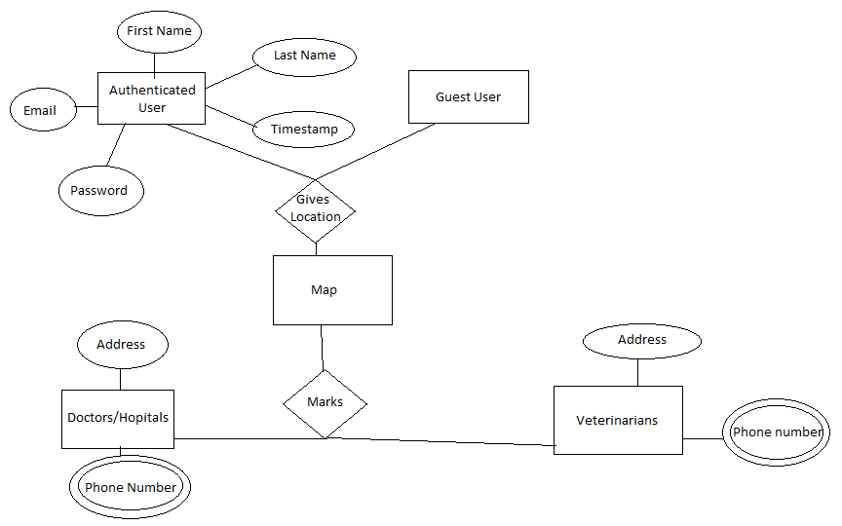
Design

Slide 8
Testing
Black-box testing :
The software interface was tested. Application has been tested for proper acceptance of user’s current geolocation coordinates and other data field inputs.
White-box testing:
The logic of the software was tested which required extensive knowledge of the source code.
Unit testing:
Various modules have been tested for proper information flow as well error handling in different modules.

